Slide 1
BITS Pilani
Prof.Aruna Malapati
Asst Professor
Department of CSIS

Slide 2
Constituency Grammars

Slide 3
Today’s Agenda
Constituents

Slide 4
Constituency Grammars
How do we know if a sentence is grammatically correct?
Linguistic phrases form a hierarchical structure called parse trees.
Today we will learn how to
  Formalize
  How to learn this from data and then apply to sentences?

Slide 5
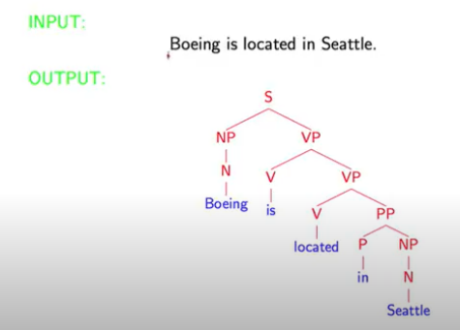
Parsing (Syntactic structure)

Slide 6
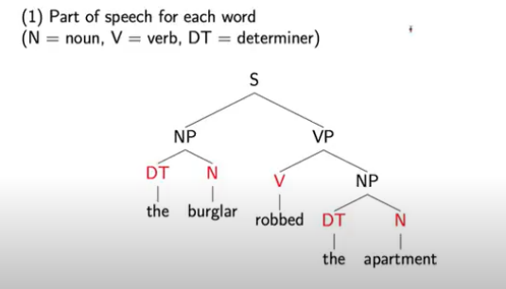
The information conveyed by parse trees

Slide 7
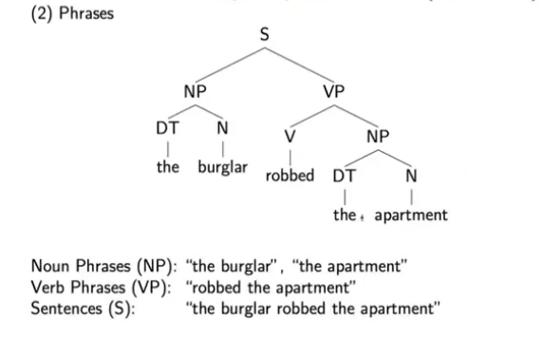
The information conveyed by parse trees

Slide 8
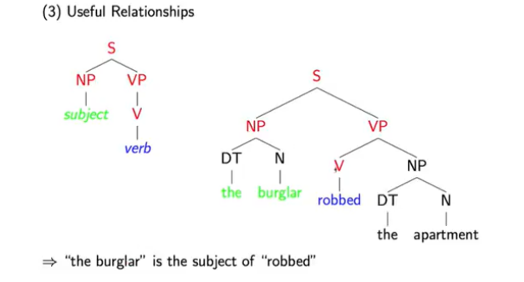
The information conveyed by parse trees

Slide 9
Application of Parsing

Slide 10
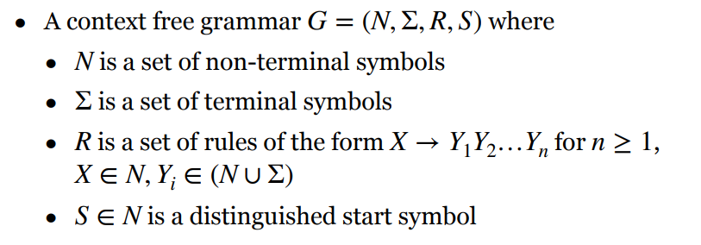
Context Free Grammar

Slide 11
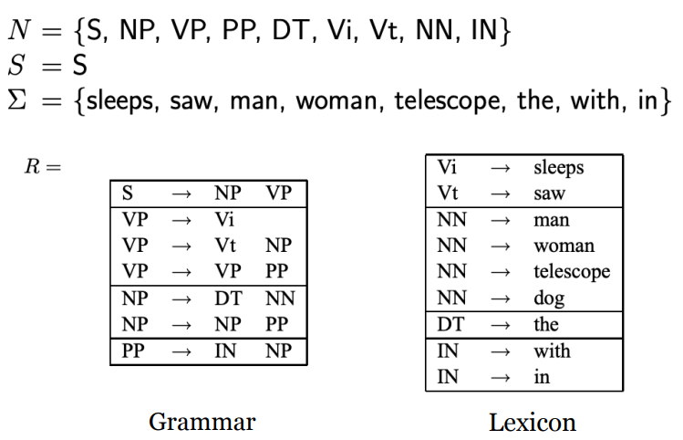

A Context-Free Grammar for English

Slide 12
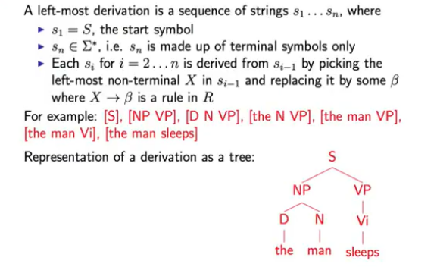
Left Derivation

Slide 13
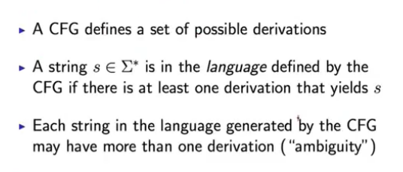
Properties of CFGs

Slide 14
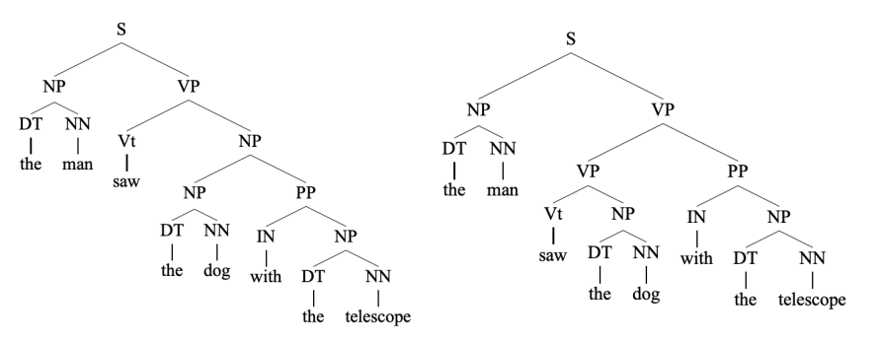
Ambiguity
Some strings may have more than one derivations (i.e. more than one parse trees!).

Slide 15
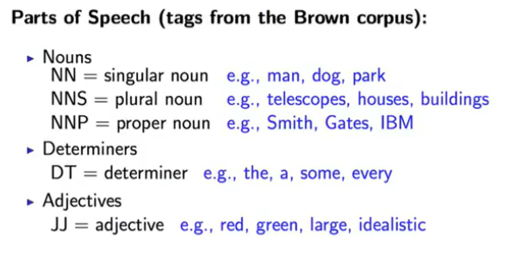
A brief overview of English Syntax

Slide 16
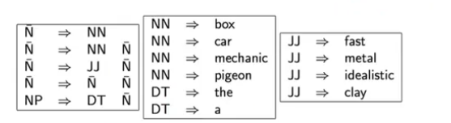
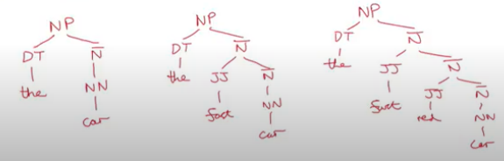
A fragment of a Noun Phrase Grammar

Slide 17
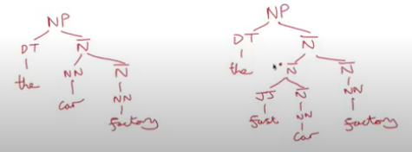
A fragment of a Noun Phrase Grammar

Slide 18
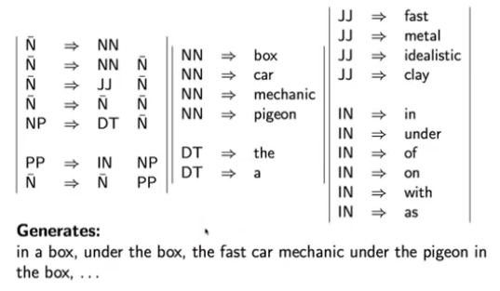
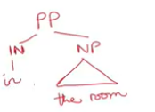
Prepositions and Prepositional phrases

Slide 19
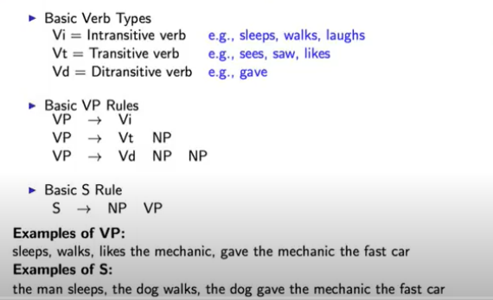
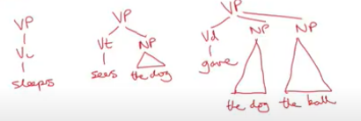
Verbs, Verb Phrases and sentences

Slide 20
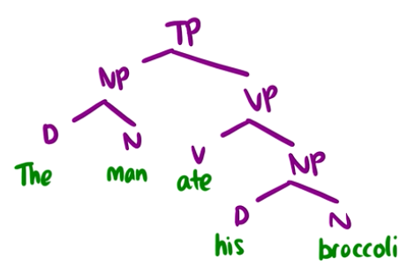

Constituents
A group of words that function together as a unit.

